Slide 1


Support Vector Machine
With an Introduction to Supervised Learning
Kardi Teknomo (ADMU)
Kristofer delas Penas (UPD)

Slide 2
Overview & Learning Objectives
Supervised Learning
Occam Razor
Overfitting
Model Validation
SVM
Concept
Separable case
Non separable case
Kernel
Kernel Trick

Slide 3
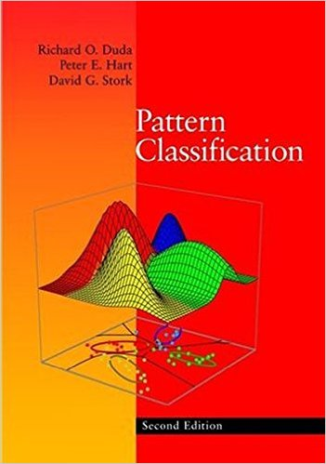
Part 1: Supervised Learning

Slide 4
Supervised Learning
Supervised Learning = Pattern Recognition = Classifier
With such a wide variety of algorithms to choose from, which one is best?
Are there any reasons to prefer one algorithm over another?
Occam‘s razor gives a principle to select among equally-best algorithms.

Slide 5
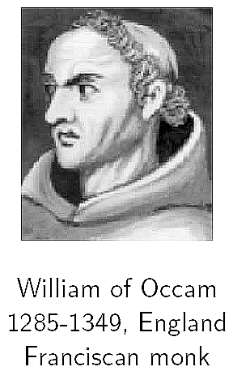
Occam’s razor
Pluralitas non est ponenda sine necessitate
= Plurality should not be posited without necessity.
Prefer the simplest hypothesis consistent with data.

Slide 6
Occam’s razor
If two theories explain the facts equally well, then the simpler theory is to be preferred.
There are fewer short hypotheses than long hypotheses.
A short hypothesis that fits the data is unlikely to be a coincidence.
A long hypothesis that fits the data may be a coincidence.

Slide 7
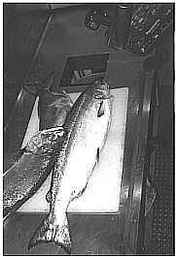
Supervised Learning Example
“Sorting incoming Fish on a conveyor according to species using optical sensing”
Sea bass
Species
Salmon

Slide 8
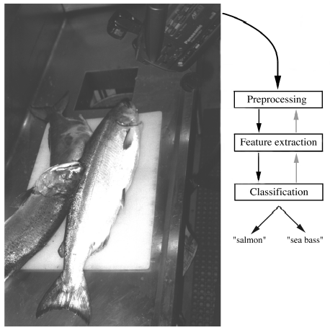
The System

Slide 9
Problem Analysis (hypothesis)
Set up a camera and take some sample images to extract features
Length
Lightness
Width
Number and shape of fins
Position of the mouth, etc…
This is the set of all suggested features to explore for use in our classifier!

Slide 10
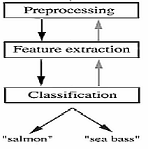
Preprocessing
Use a segmentation operation to isolate fishes from one another and from the background
Information from a single fish is sent to a feature extractor whose purpose is to reduce the data by measuring certain features
The features are passed to a classifier

Slide 11
Classification
Select the length of the fish as a possible feature for discrimination

Slide 12
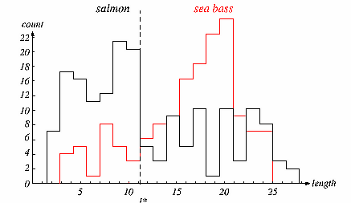
Data ➔ Histogram of Fish Length

Slide 13
Feature Selection
The length is a poor feature alone!
Select the lightness as a possible feature.

Slide 14
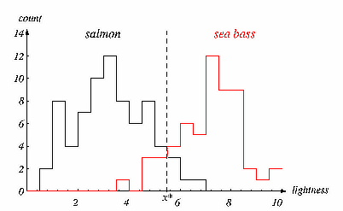
Data ➔ Histogram of Lightness

Slide 15
Threshold Decision Boundary
Move our decision boundary toward smaller values of lightness in order to minimize the cost (reduce the number of sea bass that are classified salmon!)
Task of decision theory

Slide 16
Feature Selection
Adopt the lightness and add the width of the fish
Fish x^{T} = [x₁, x₂]
Lightness
Width

Slide 17
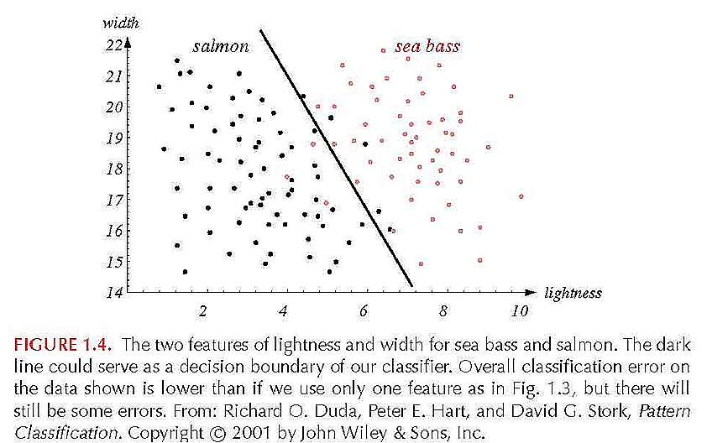
Salmon or Sea Bass?

Slide 18
Discussion: Feature Selection
What Applications can you suggest to use Supervised Learning?
What features do you select to create those applications?

Slide 19
Optimal Classifier
We might add other features that are not correlated with the ones we already have. A precaution should be taken not to reduce the performance by adding such “noisy features”
Ideally, the “best decision boundary” should be the one which provides an optimal performance such as in the following figure:

Slide 20
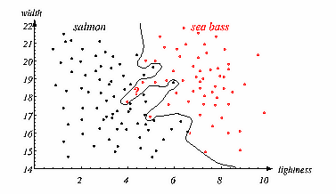

Slide 21
But ....
However, our satisfaction is premature because the central aim of designing a classifier is to correctly classify novel input
(see ? in the picture)
Issue of generalization!

Slide 22
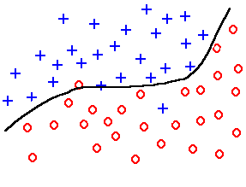
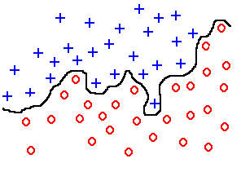
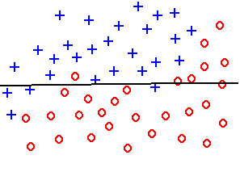
Overfitting and underfitting
Problem: how rich class of classifications q(x;θ) to use.
underfitting
good fit
overfitting
Problem of generalization: a small emprical risk R_{emp} does not imply small true expected risk R.

Slide 23
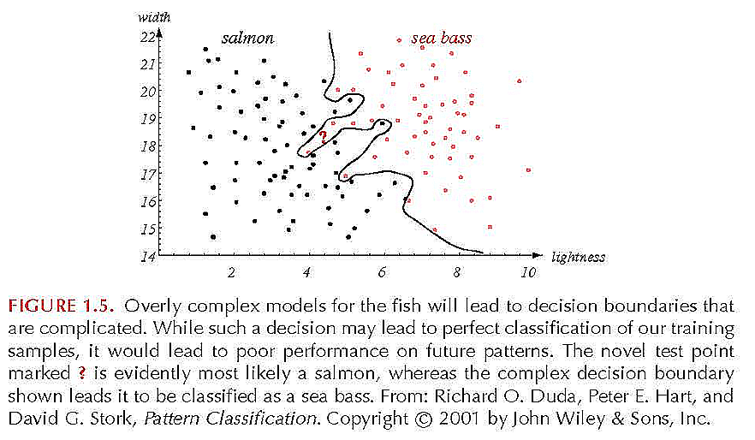
Overfitting Problem

Slide 24
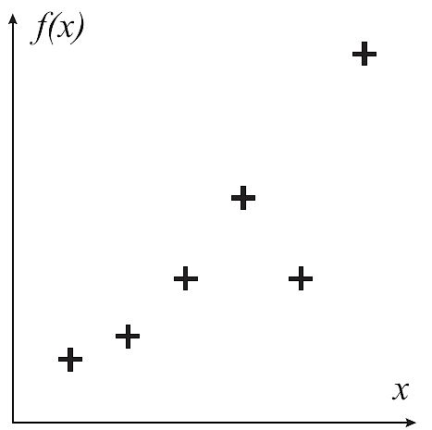
Example: Function Approximation

Slide 25
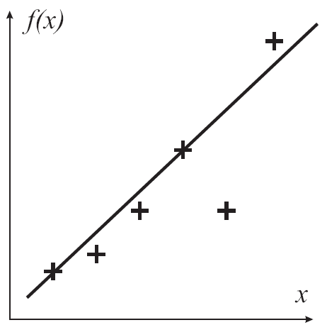
Example: Function Approximation

Slide 26
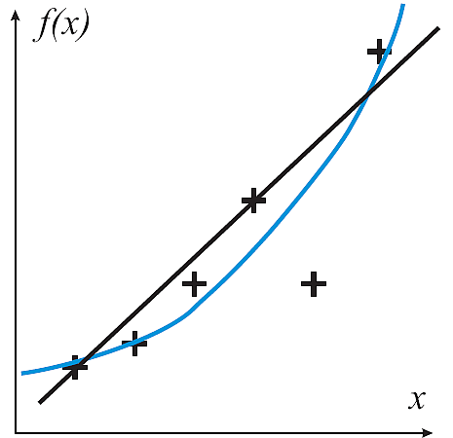
Example: Function Approximation

Slide 27
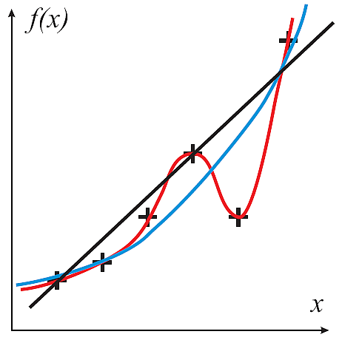
Example: Function Approximation

Slide 28
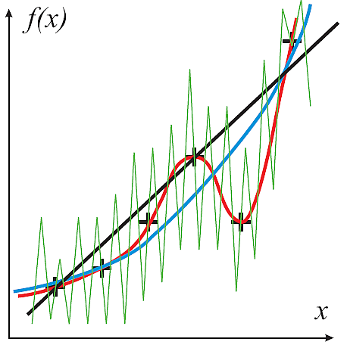
Example: Function Approximation

Slide 29
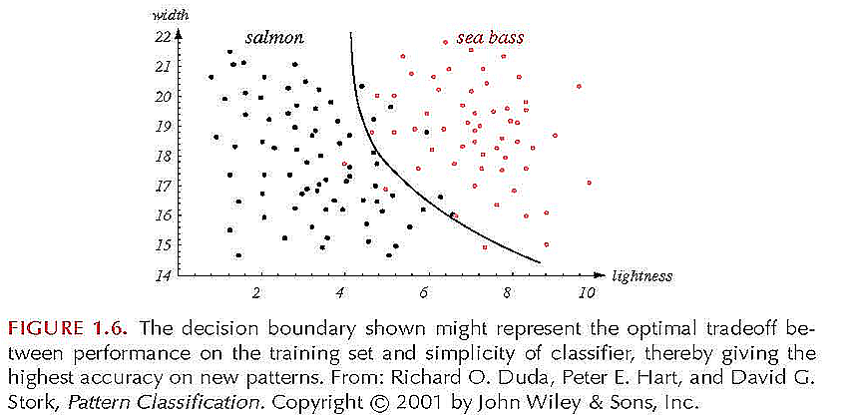
Non-Linear Decision Boundary

Slide 30
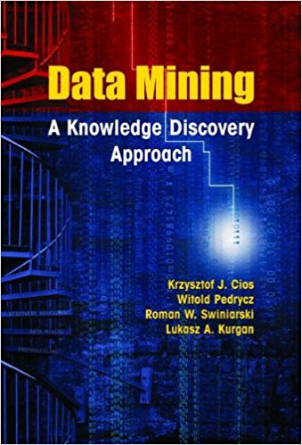
Overfitting & Underfitting
Overfitting = unnecessary increase in model complexity
By increasing number of parameters
By increasing degree of freedoms
increase model variance
Underfitting = too simple model that will not fit the data

Slide 31
Discussion: Overfitting
Why overfitting is bad?
How do you overcome overfitting?

Slide 32
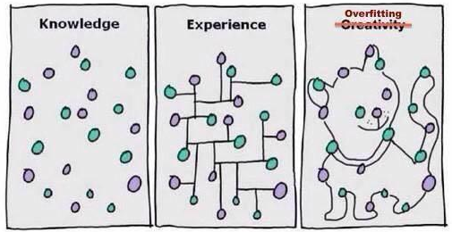
Overfitting

Slide 33
Overcoming Overfitting
Model selection: find model (or model parameters) with the right complexity without overfitting or underfitting
To measure model performance, compute misclassification error, accuracy etc. based on
All data as training sample
Hold out method
Cross Validation
K-Fold Validation
Leave One Out

Slide 34
All data as training sample
We can use all of our data as training sample, and even if we get 100% correctly classified, we never know if the model is robust enough to predict previously unseen record
Worst scenario of training without testing
Susceptible to overfitting
training sample

Slide 35
Hold out method
Partition data into two parts:
Training data set
Test data set
Composition: 50-50, 60-40, or 75-25
Calibrate the model using training data
Test using test data set
Training data + test data = total data
test sample
training sample

Slide 36
Limitation of Hold Out Method
Training sample is not enough to produce good model (some classes are not included)
Smaller training set size, larger the variance ➔ model is not accurate
If training set is large then test set is small, then testing is not reliable
training sample
test sample
training sample
test sample

Slide 37
Cross Validation
Each record is used the same number of times for training and exactly one for testing
Two folds cross validation:
Divide data into 2 of equal size
First data for training set, second for testing
Then swap and run again
Total error is the summation of both runs
test sample
Training
sample
training sample
test sample

Slide 38
K-fold cross validation
Divide data into K equal size partition
(K-1) partition is used for training and 1 for testing
Repeat the procedure K times so that each partition is used for testing exactly once
Total error is the sum up of errors for all k runs
test sample
training sample
training sample
training sample
training sample
test sample
test sample
test sample

Slide 39
Leave one out method
test sample
training sample
training sample
training sample
training sample
test sample
test sample
test sample
Leave one out = K fold cross validation with K=N
Each test contain only one record
Advantages:
utilizing most data for training
Effectively cover the entire data set
Disadvantages:
Computationally very expensive to repeat run N times
Variance tends to be high because only 1 test data

Slide 40
Copy right
Permission is granted to use, modify and distribute this slide as long as the copy right page remain intact and unmodified.
Copyright © 2017 Kardi Teknomo (http://people.revoledu.com/kardi/tutorial/)

